Slide 1
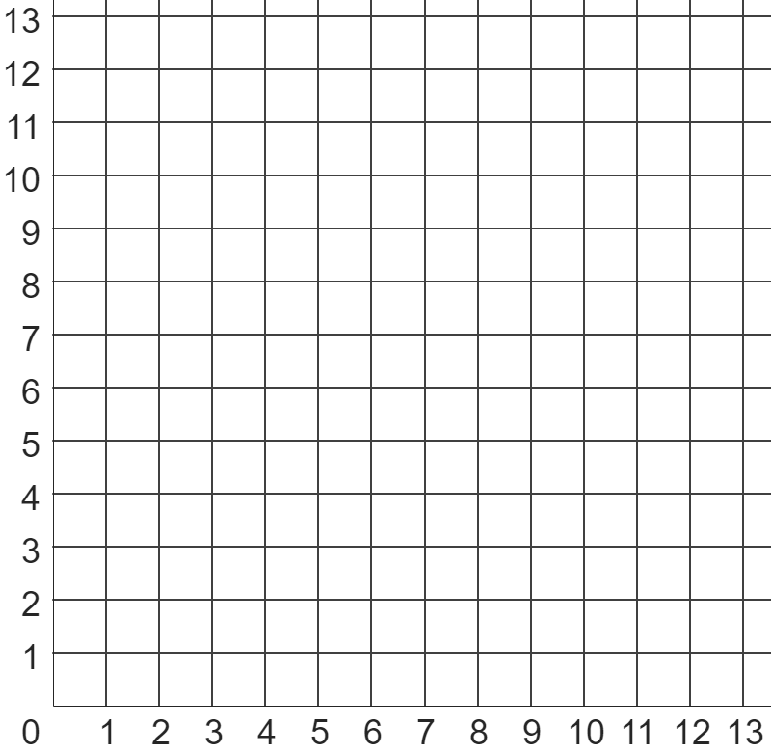
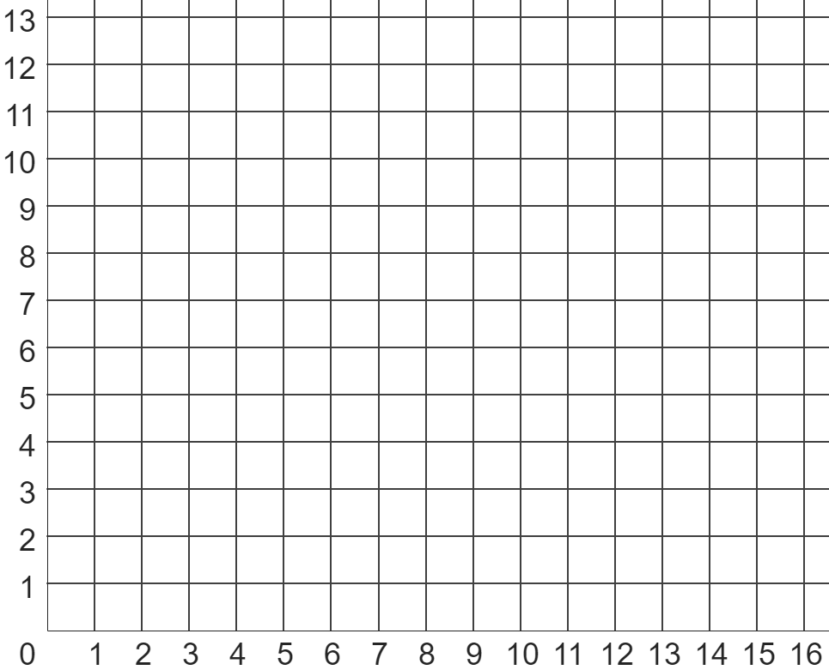
Problem solving with similarity and Pythagoras’ theorem
Task A: Pythagoras’ theorem with coordinates
B
1) Use Pythagoras’ theorem to find the shortest distance (to 1 d.p) between points:
A
a) A and B
b) A and C
c) B and D
d) C and D
e) B and E
6.7 units
4.5 units
8.1 units
8 units
12.2 units
C
D
E
scalene
triangle
2) Calculate the perimeter of each shape (to 2 d.p.).
square
square
4 × 3.60555
14.42 units
isosceles triangle
2 × 7.071 + 10
24.14 units
isosceles
triangle
scalene triangle
5.83095 + 5 + 6.08276
16.91 units
3) Write down three coordinates whose vertices make a triangle with a perimeter of between 20 and 22 units in length.
Show this is correct using Pythagoras’ theorem.
There are many possible solutions, such as a triangle with vertices (4, 6), (3, 12) and (10, 8)

Slide 2


Problem solving with similarity and Pythagoras’ theorem
Task B: Pythagoras’ theorem with ratios
1) Each of these three widescreen TVs have width and height in the ratio 16 : 9.
8 inches
12 inches
a) Complete each sentence by choosing the appropriate word below.
screen A
similar
Each of the TVs is ___________ to the others.
screen B
width
height
This is because their _________ and _________ are in ___________ to each other.
proportion
scale factor
30 inches
The ___________ from screen A to B is 1.5.
b) By using Pythagoras’ theorem, complete the ratio table for screen B (3 d.p.)
width | height | diagonal
16 | 9 | 18.358
10.459 | 5.883 | 12
screen C
c) Hence, calculate the width of screens A and C (2 d.p.)
screen A: 10.459 ÷ 1.5 = 6.97 inches
screen C: 10.459 × 2.5 = 26.15 inches
2) Izzy wants to buy this ultra widescreen TV, which has a width and height in the ratio 22 : 9.
The TV has a 35 inch screen, and a stand that is 2 inches high.
Will the TV fit inside her TV cabinet?
TV cabinet
36 inches
15 inches
width | height | diagonal
22 | 9 | 23.77
32.39 | 13.25 | 35
No, the TV will not fit in the cabinet.
Whilst the screen is less than the width and height of the cabinet, the TV’s 2 inch stand makes the TV too tall.

Slide 3

Problem solving with similarity and Pythagoras’ theorem
3) Jacob sees three TVs for sale, each having a 28 inch screen.
Jacob wants to buy the TV whose screen has the largest area.
Which TV should he buy?
summary table of solutions
retro TV (4 : 3 aspect ratio)
widescreen TV (16 : 9 aspect ratio)
ultra widescreen TV (22 : 9 aspect ratio)
TV | width | height | area
retro | 22.4 | 16.8 | 376 inches²
widescreen | 24.4 | 13.7 | 335 inches²
ultra widescreen | 25.9 | 10.6 | 275 inches²
Even though all three TVs have a diagonal length of 28 inches, the retro TV has the screen with the largest area.
Mathematics in Education and Industry.
v2.3

